Slide 1
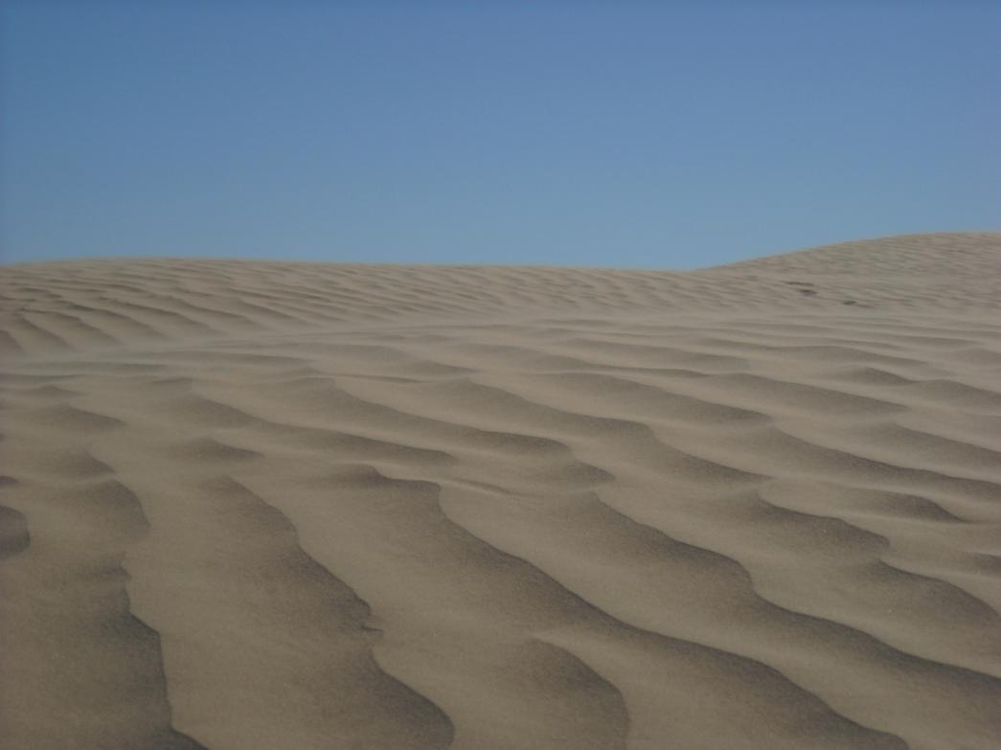
ESS Field Trip
September 2009

Slide 2
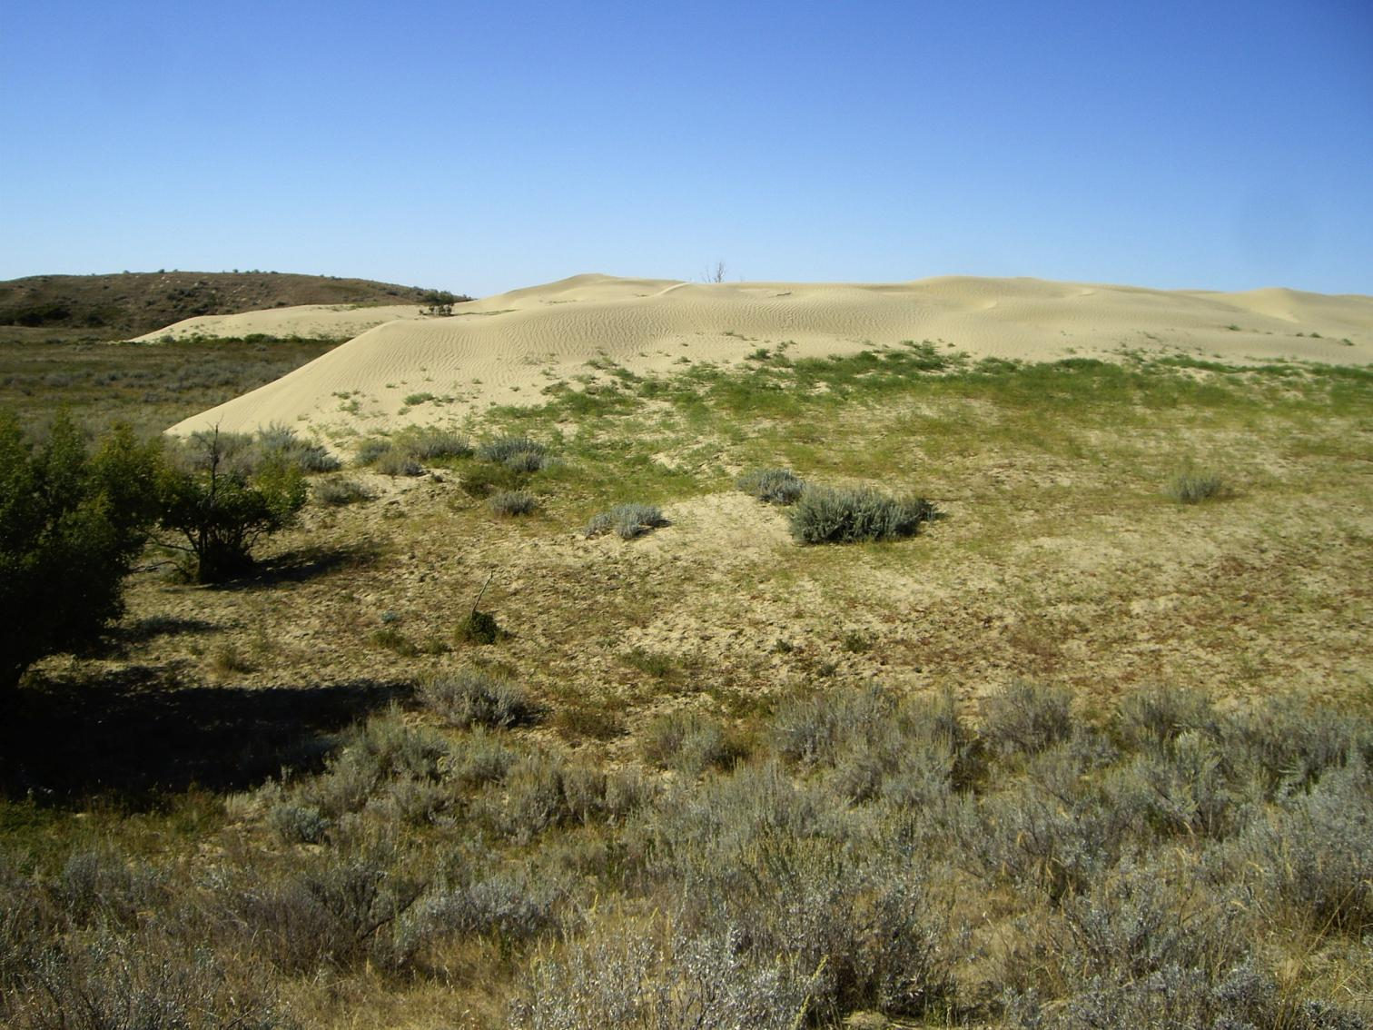
Itinerary
Friday evening – Ingebright Lake
Saturday morning – Great Sand Hills
Saturday afternoon – Cypress Hills Winery
and Park
Sunday morning – Checkerboard Hill and
South Saskatchewan River Walk
Notes:
Friday evening – Ingebright Lake
Saturday morning – Great Sand Hills
Saturday afternoon – Cypress Hills Winery
and Park
Sunday morning – Checkerboard Hill and
Daisy’s Farm Friday evening – Ingebright Lake
Saturday morning – Great Sand Hills
Saturday afternoon – Cypress Hills Winery
and Park
Sunday morning – Checkerboard Hill and
Daisy’s Farm Friday evening – Ingebright Lake
Saturday morning – Great Sand Hills
Saturday afternoon – Cypress Hills Winery
and Park
Sunday morning – Checkerboard Hill and
Daisy’s Farm

Slide 3
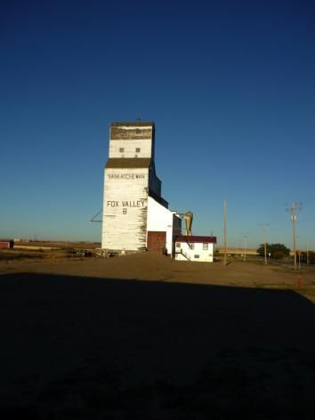
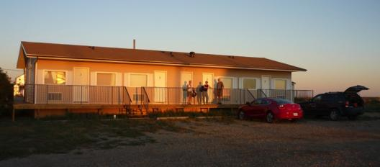
Base camp
The Fox Den Motel

Slide 4
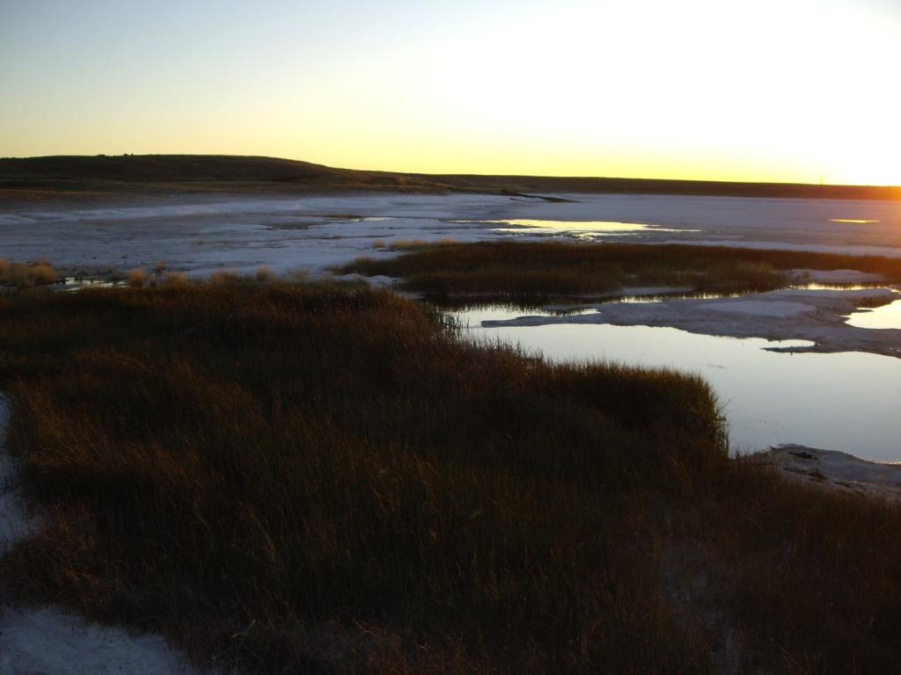
Ingebright Lake
Hypersaline lake – salinity 160 ppt
Area <1 sq km
Largest Na₂SO₄ deposit in N. America
In excess of 40m thick
Over 100 million tonnes
Owned by Sask Minerals
Presently mothballed

Slide 5
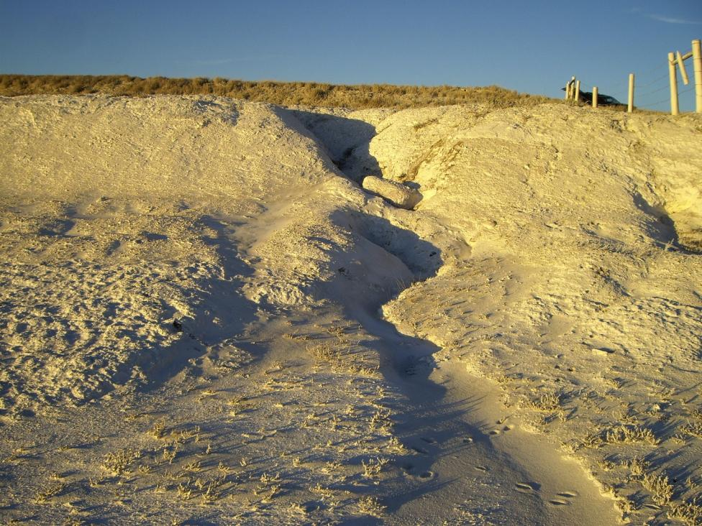

Slide 6
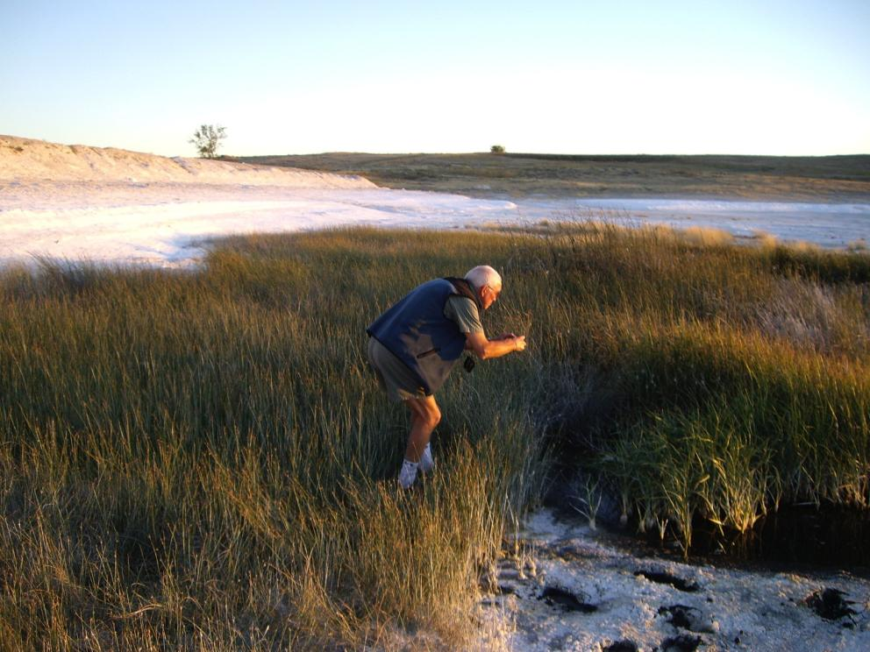
Ignore the photographer
- Note the foot holes!

Slide 7
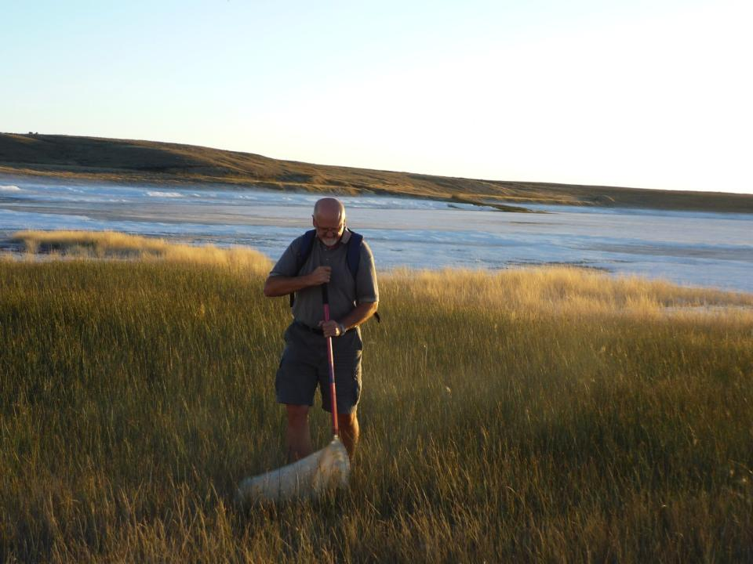
Owen demonstrating the
correct sweep net technique

Slide 8
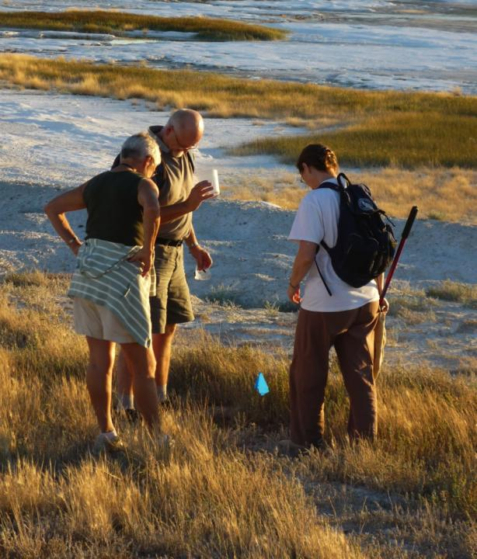
Did I finish my beer already?

Slide 9
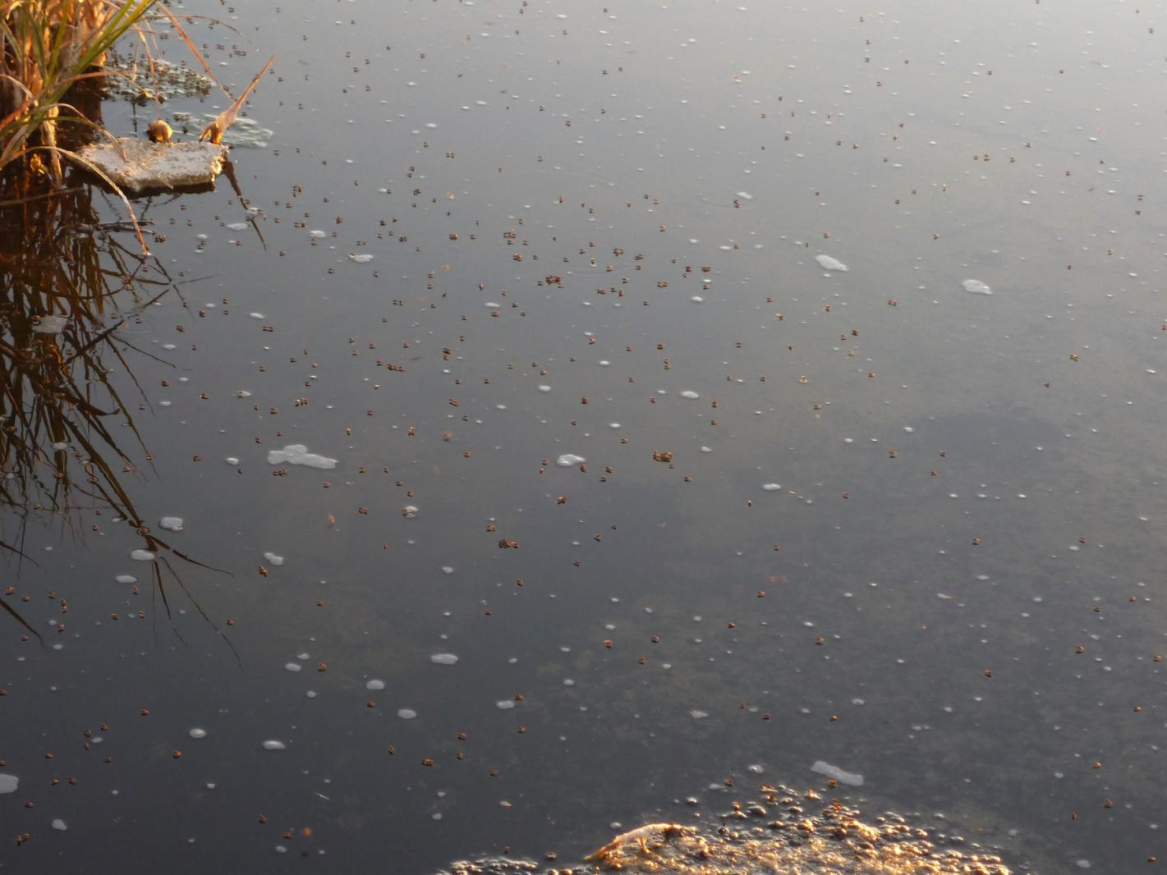
Quite likely brine flies (Ephydra [hians?])

Slide 10
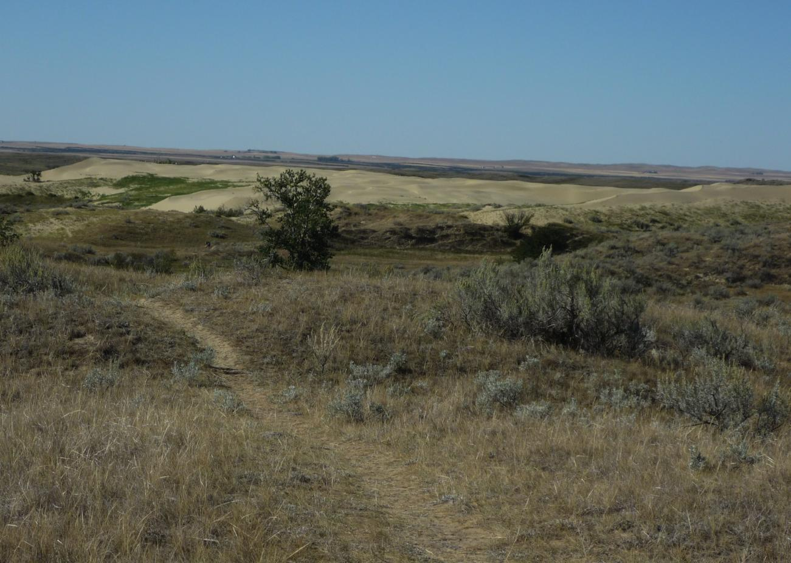
The Great Sand Hills

Slide 11
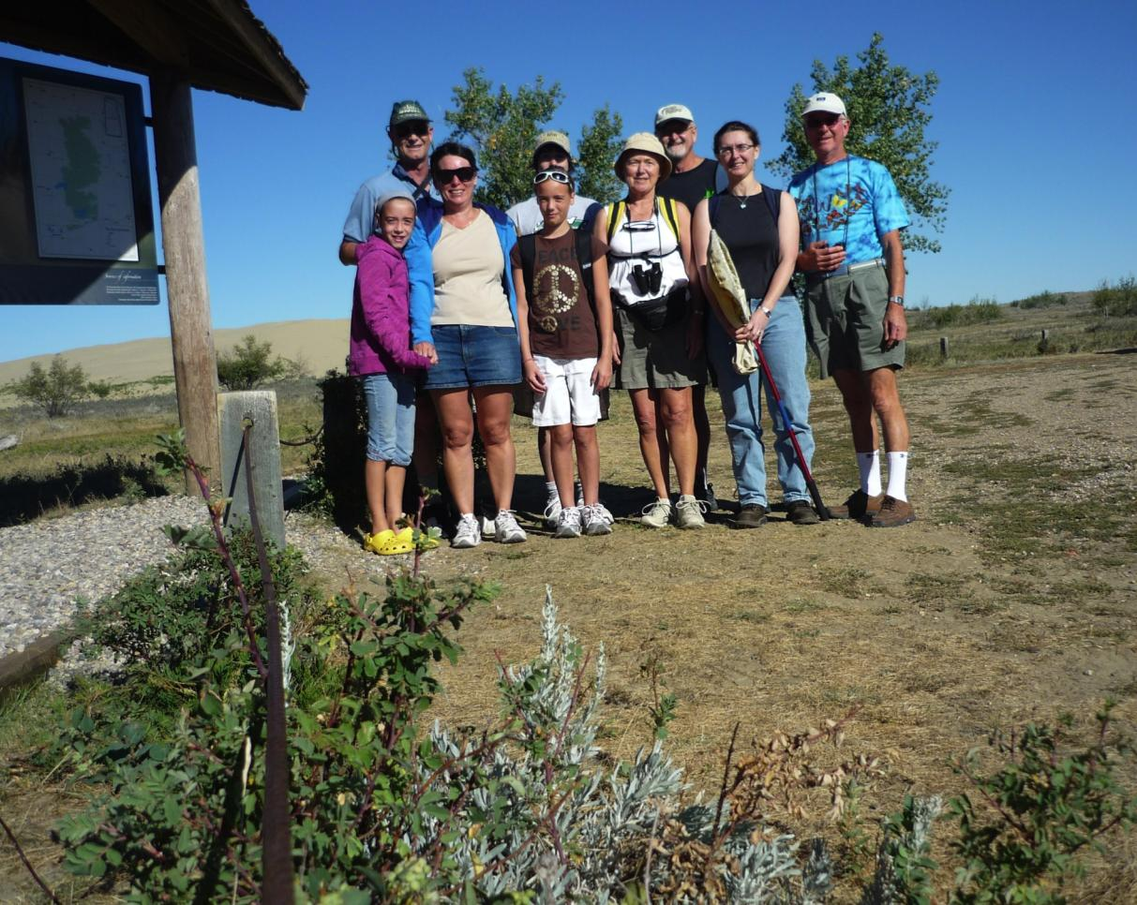
The intrepid explorers

Slide 12
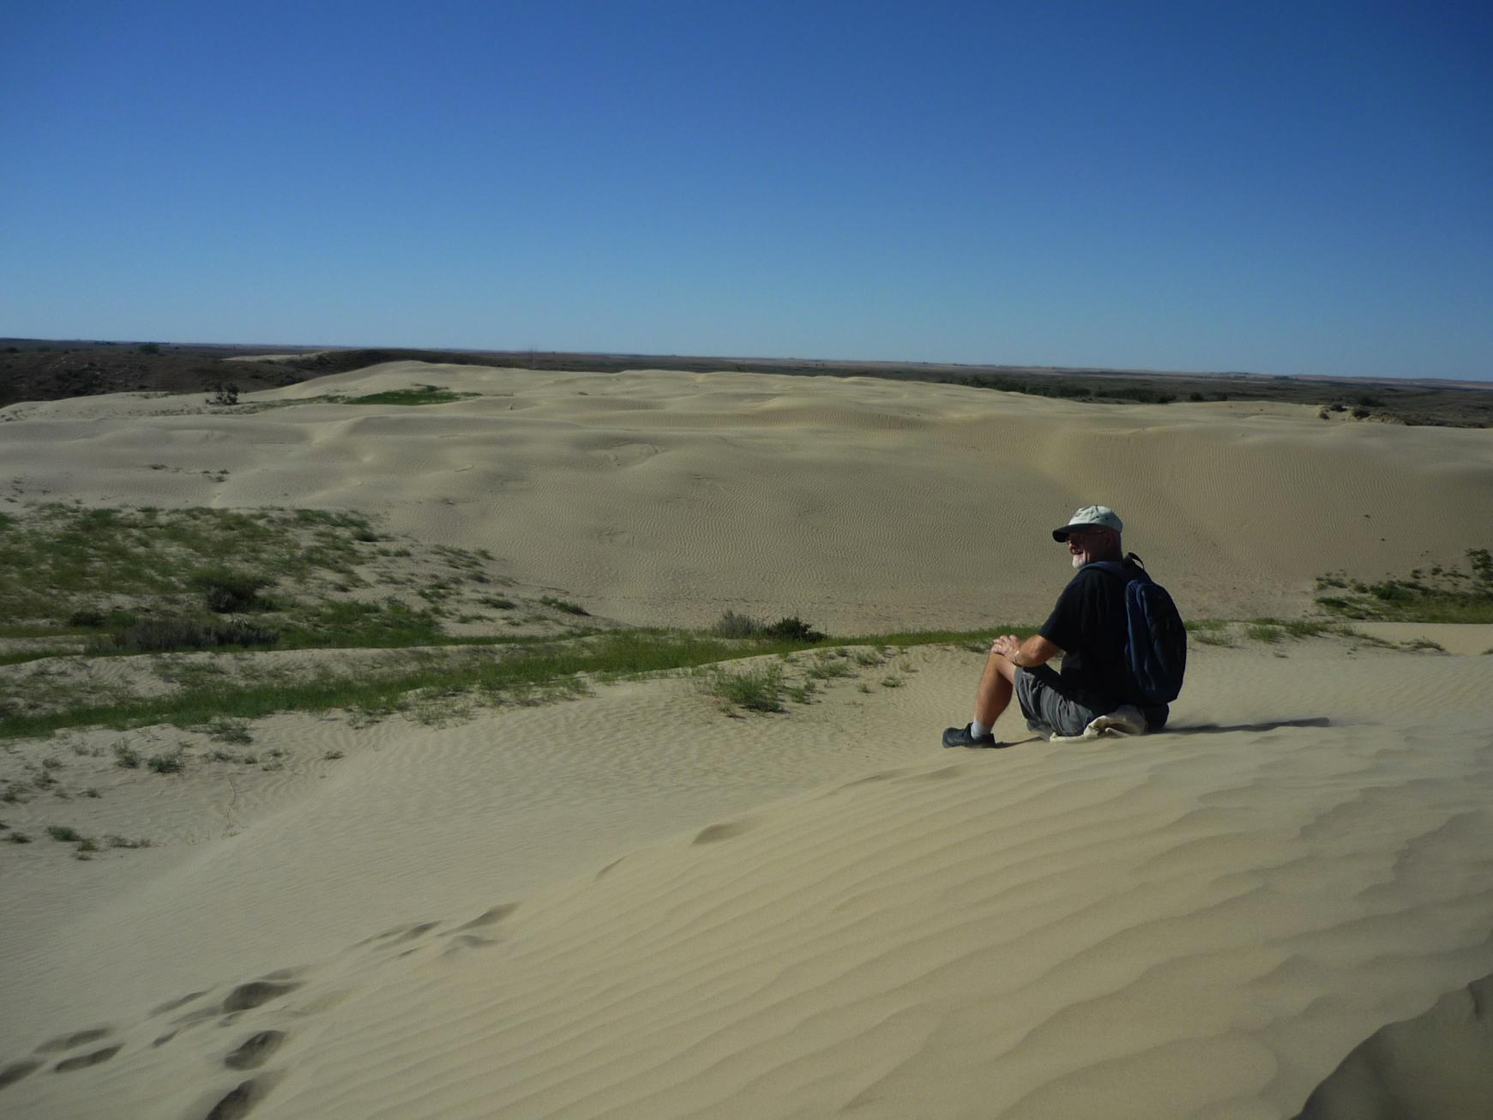
Where has everybody got to?

Slide 13
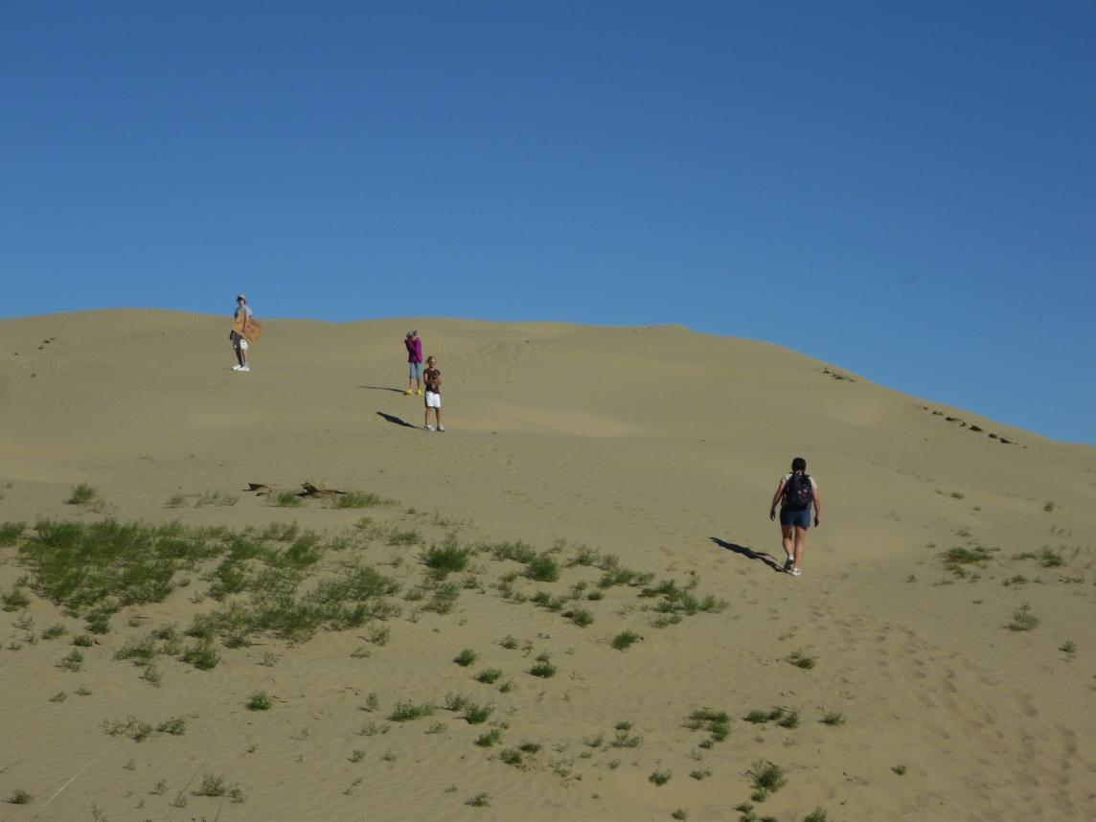
….. The sand boarders

Slide 14
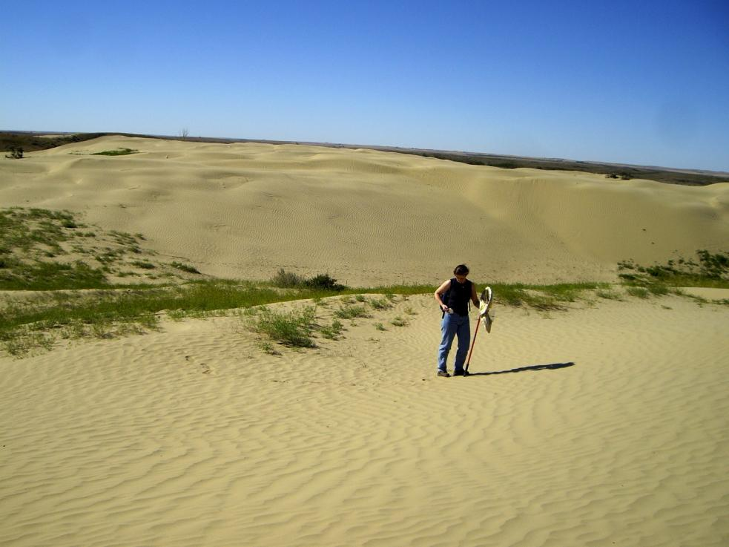
….. and the collectors

Slide 15
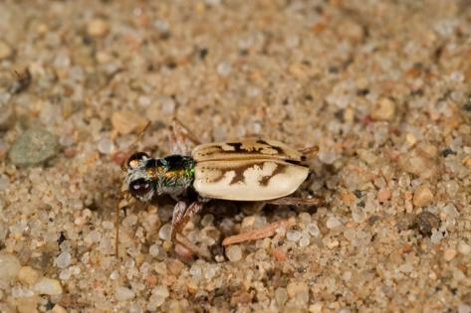
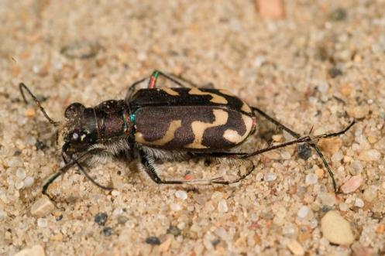
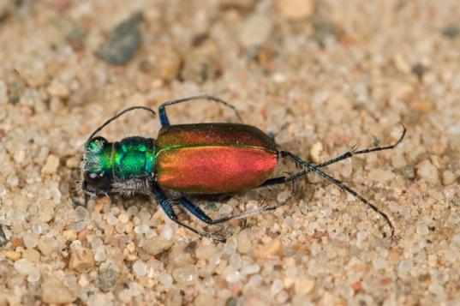
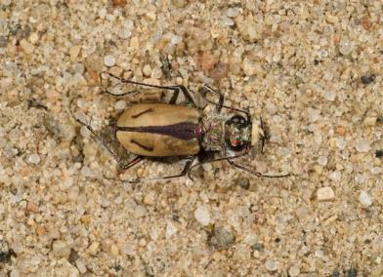
Ghost (C. lepida)
Oblique (C. tranquebarica kirbyi)
Festive (C. scutellaris)
Sandy (C. limbata nympha)

Slide 16
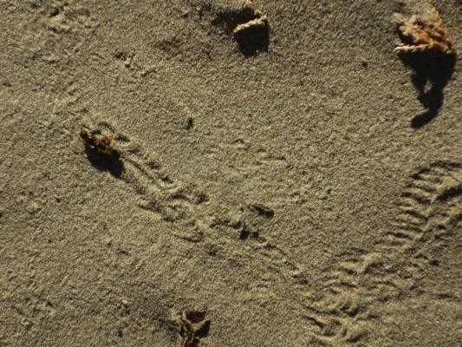
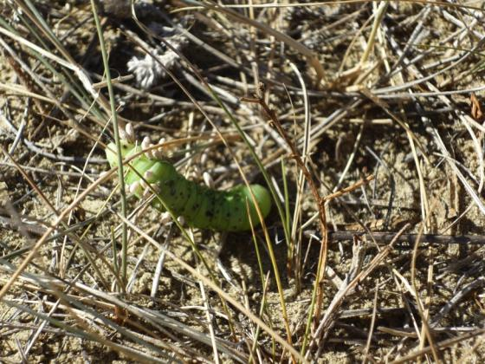
Ant hill climbing
Hornworm parasitised
by braconid

Slide 17
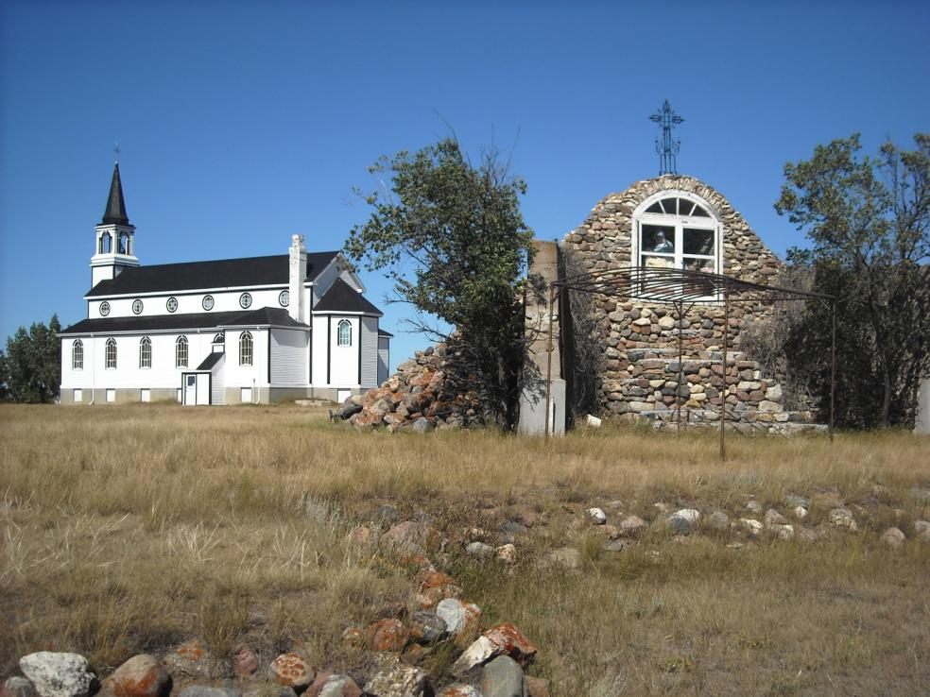
Blumenheim: St Peter & Paul Catholic Church and grotto

Slide 18
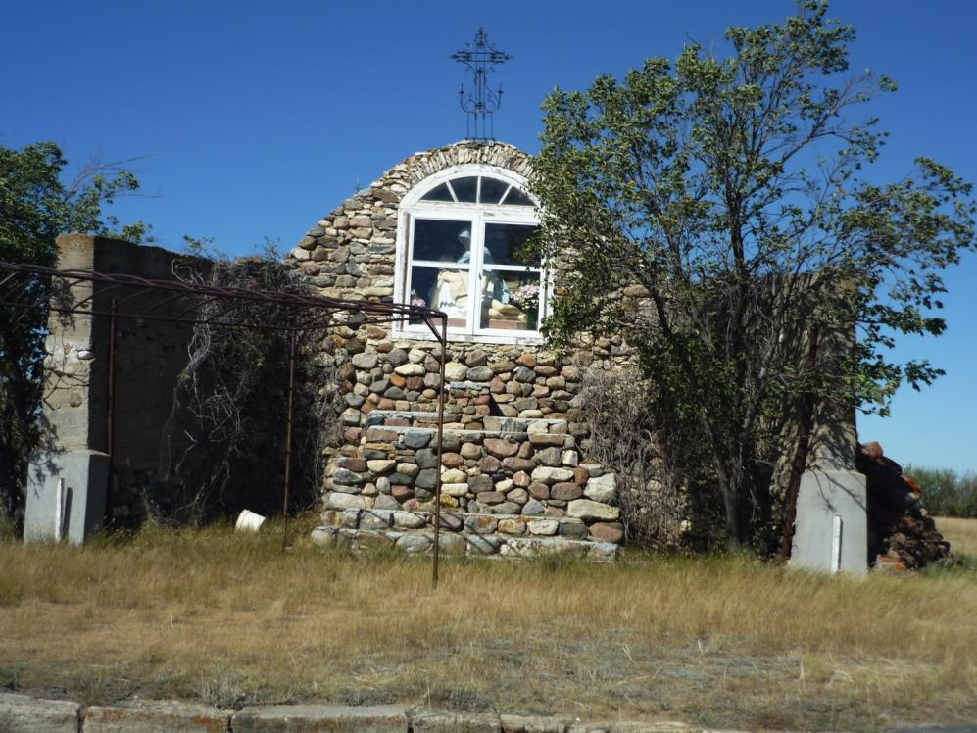

Slide 19
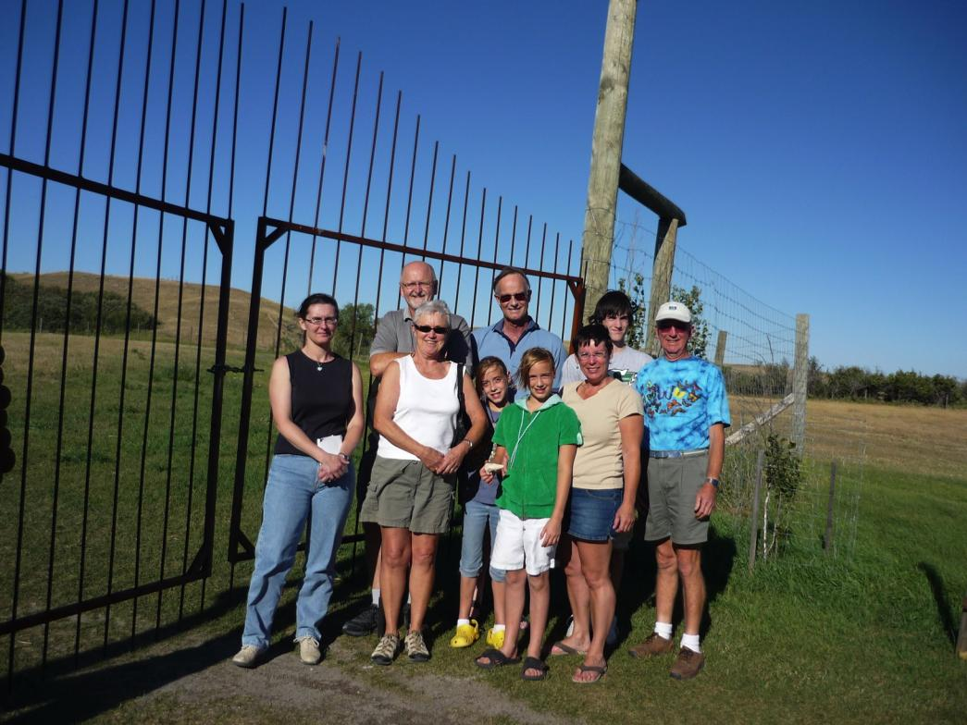
Cypress Hills Winery Visit
– purpose to collect leafhoppers, of course!

Slide 20
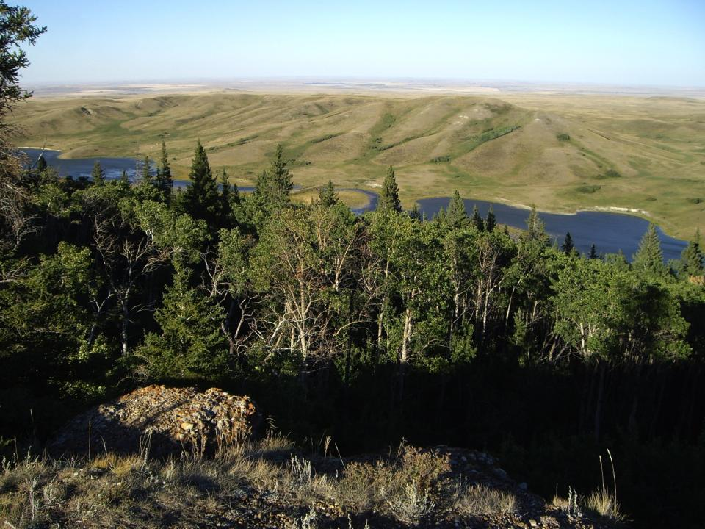
Cypress Hills Park
– Conglomerate Cliffs, looking northwest

Slide 21
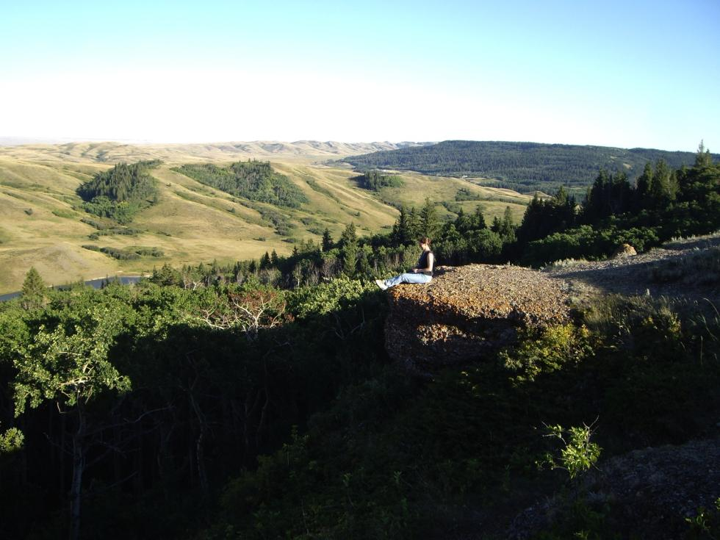
….. and looking southeast

Slide 22
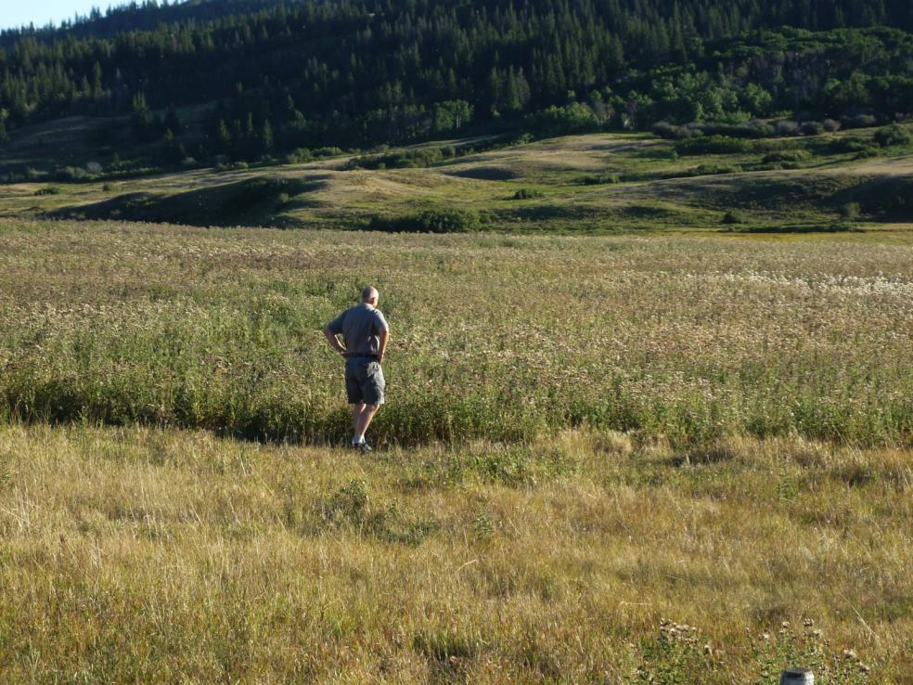
Now who would want to grow thistles?

Slide 23
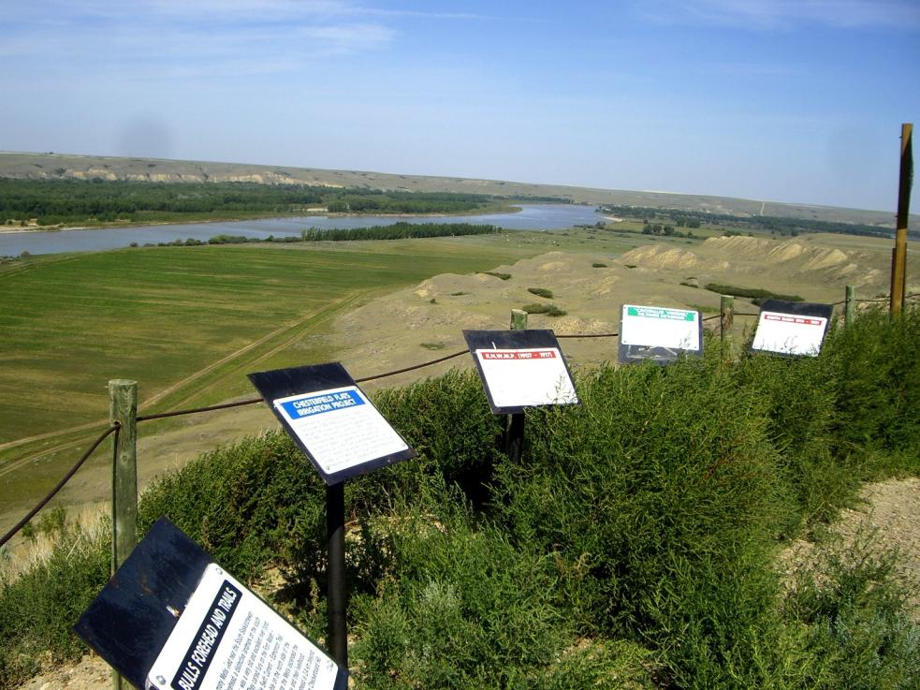
Checkerboard Hill looking northeast

Slide 24
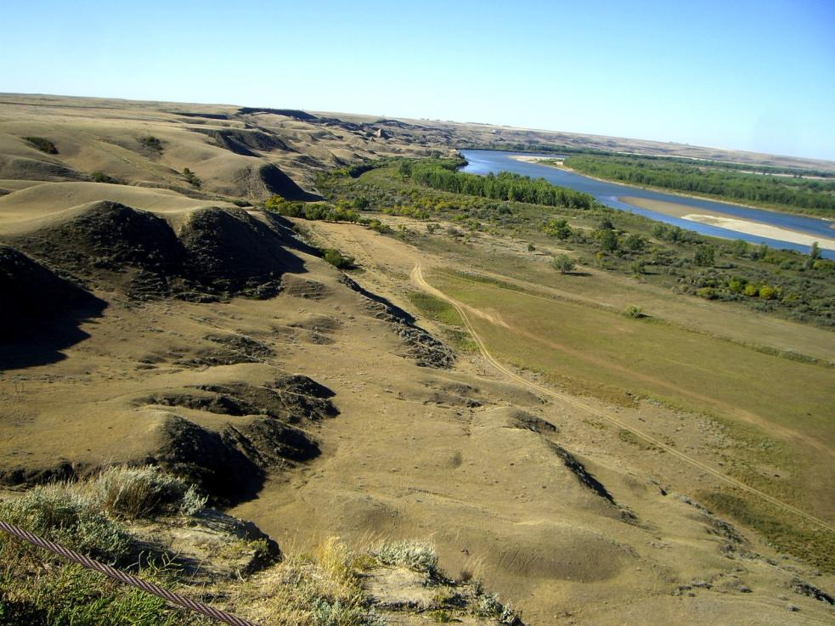
….. looking northwest
But what’s this?

Slide 25
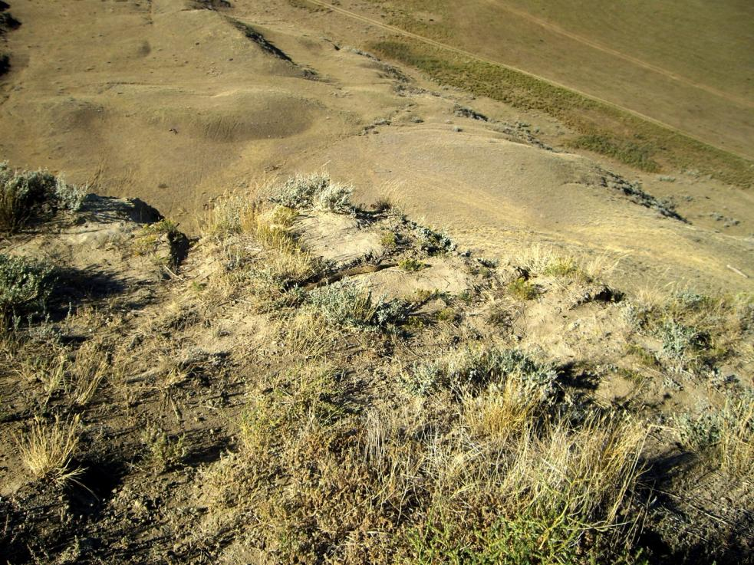
….. let’s take a closer look

Slide 26
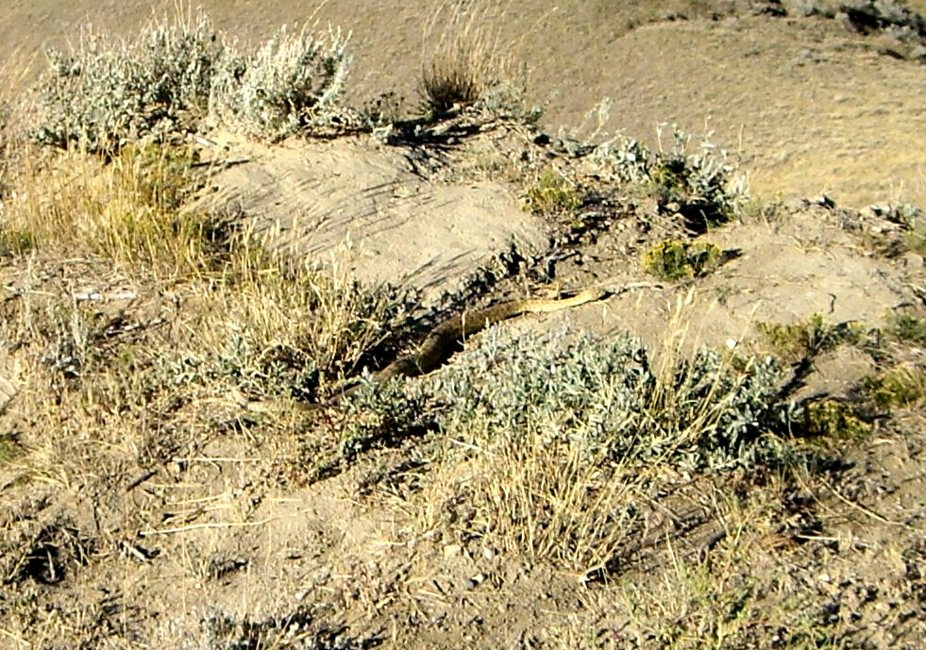
…. Prairie rattlesnake!

Slide 27
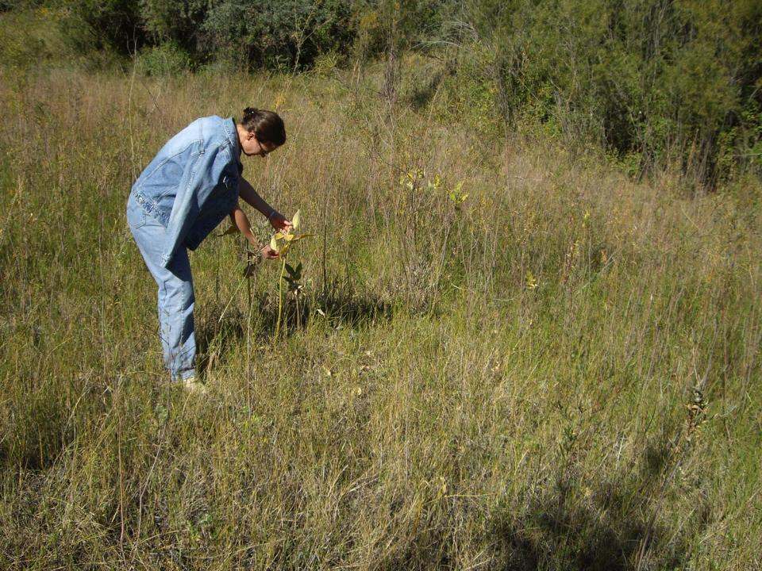
….. So, finally
South Saskatchewan River Walk

Slide 28
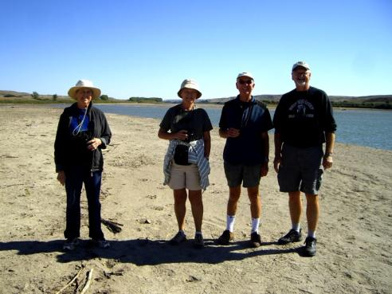
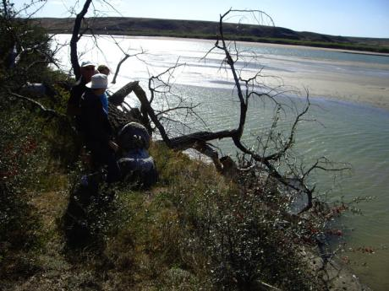
A fine ending to a fine trip!

